Slide 1
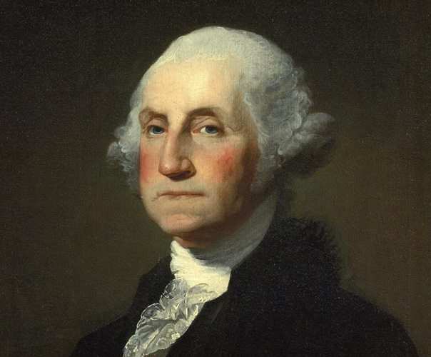
President Washington’s Cabinet Dilemmas
Cabinet Dilemma #2 Result

Slide 2
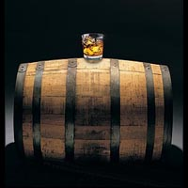
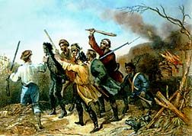
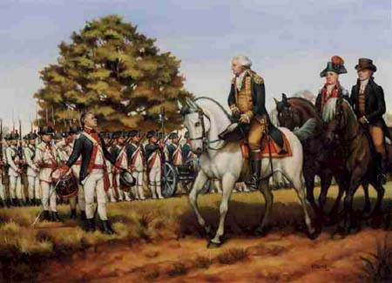
Dilemma #2 Result: Option D Whiskey Rebellion of 1794
Result: President Washington gathered a 15,000 man militia
Led the march to Pennsylvania and “crushed” rebellion without fighting
Importance: Showed strength of federal government
Used military force to establish authority over the states and citizens.

